Slide 1

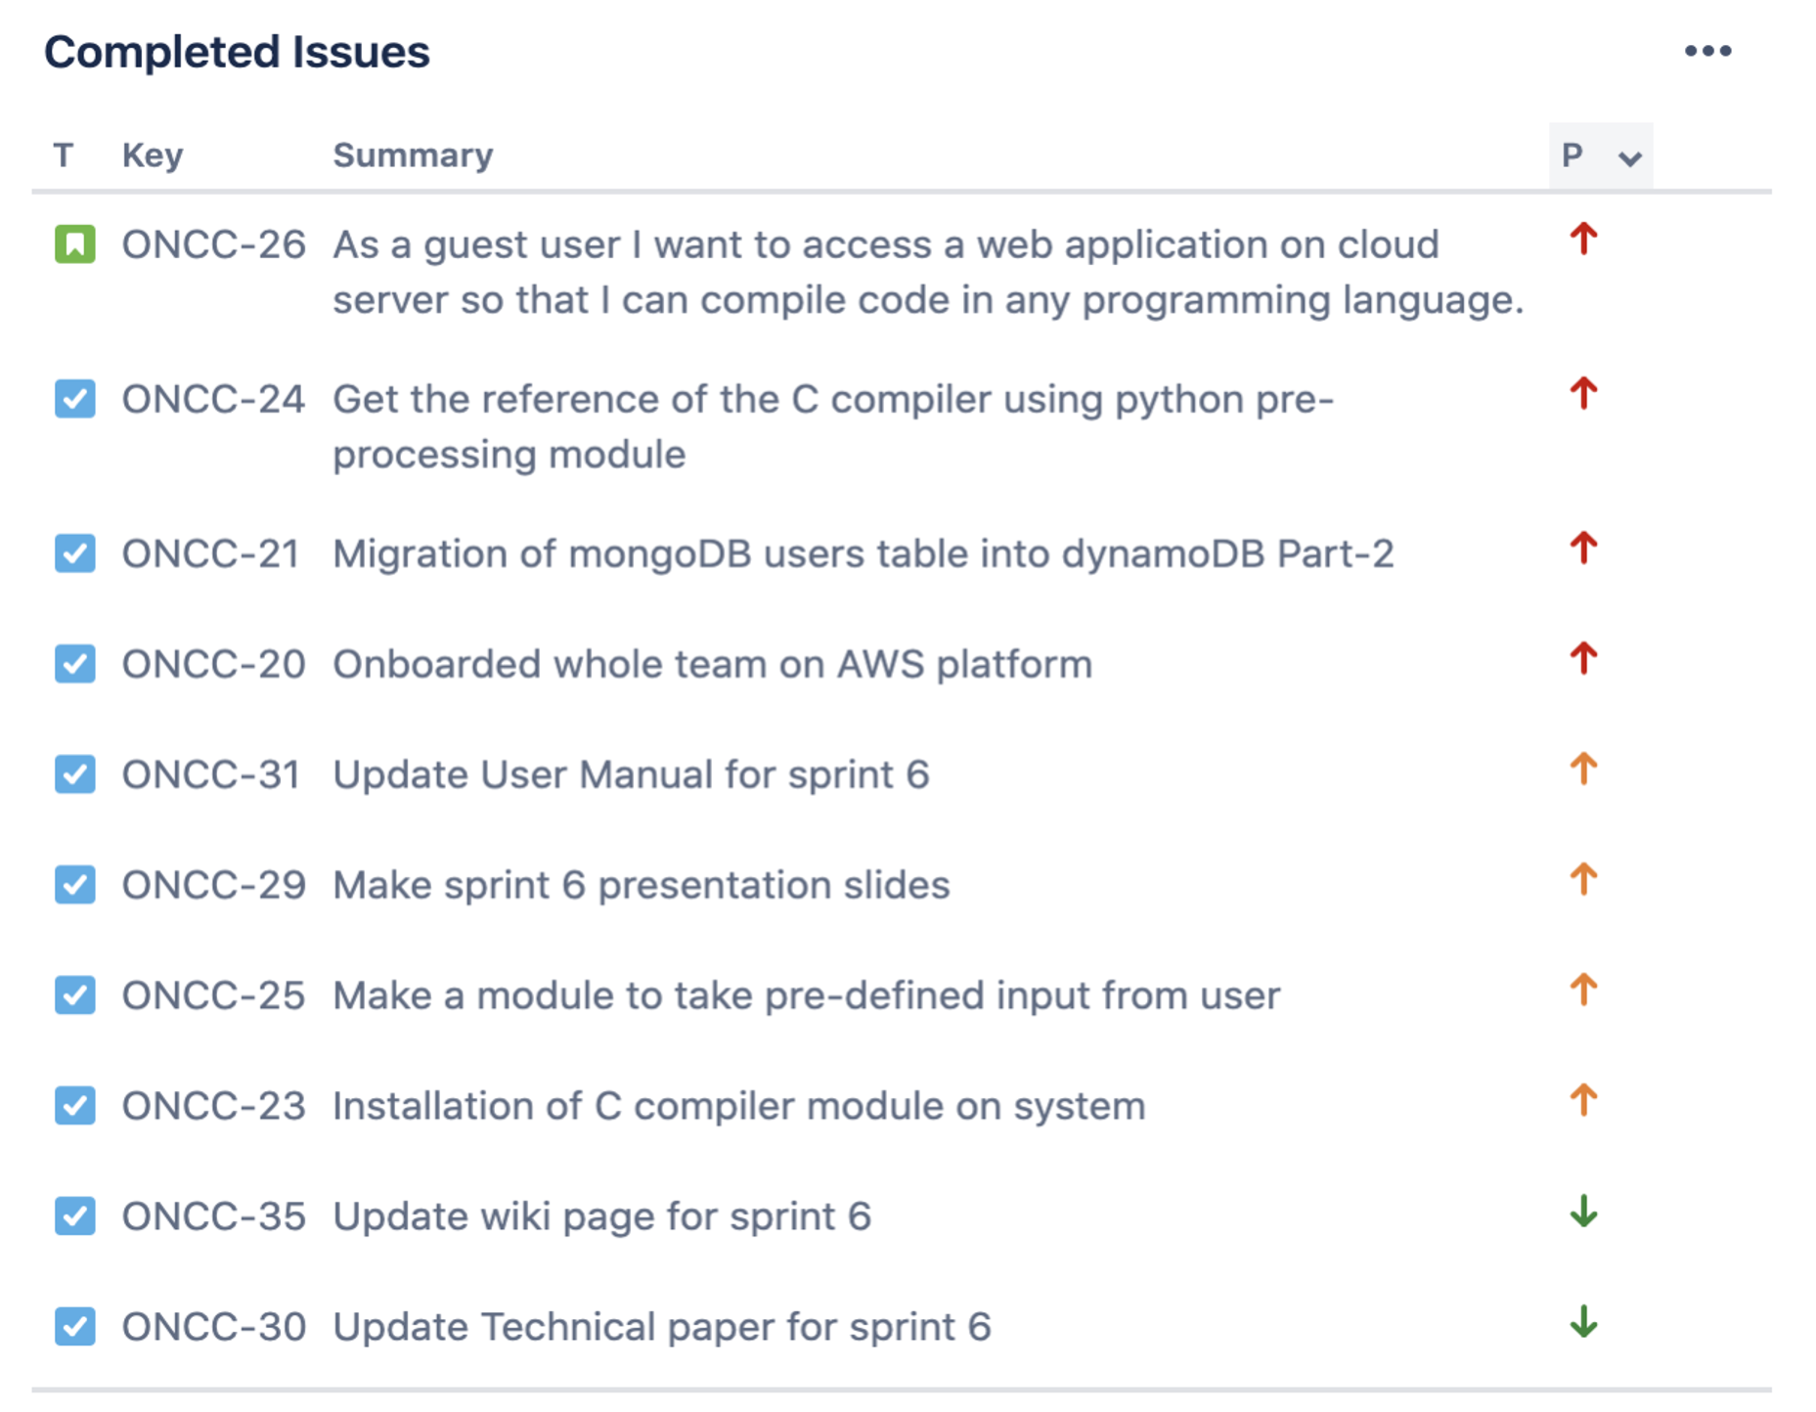


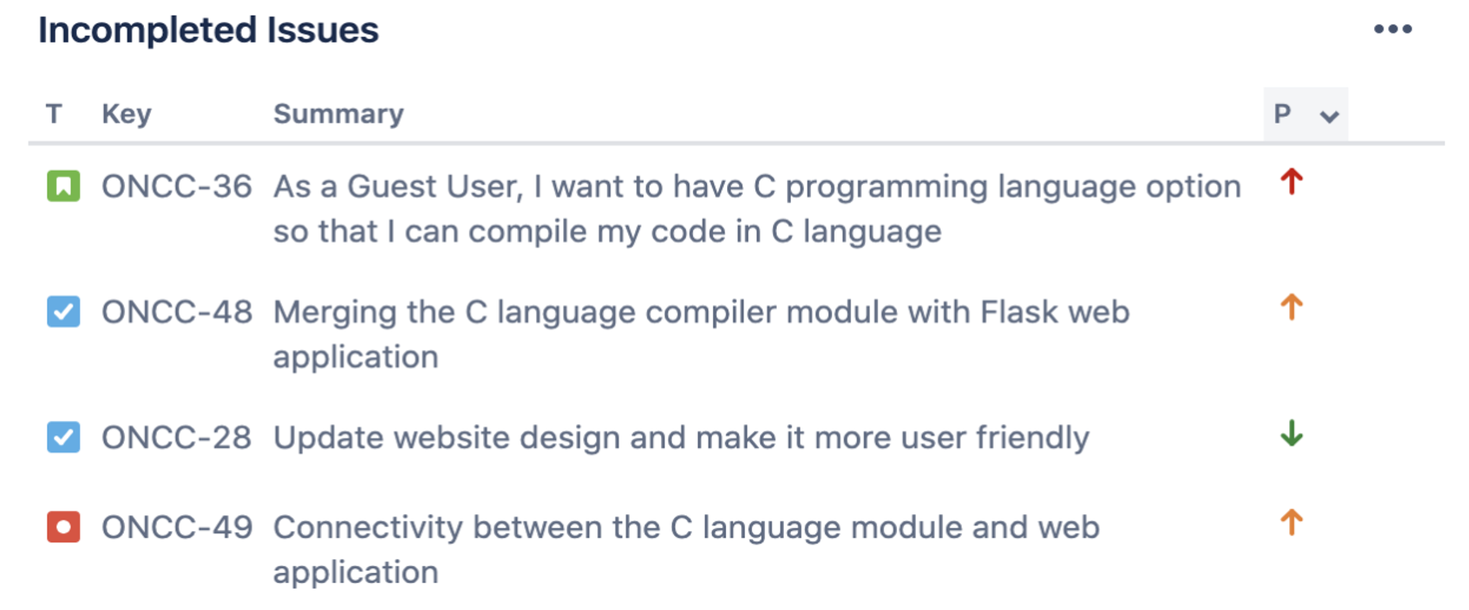

Sprint 6 Artifacts
In this sprint, we couldn’t be able to complete the highlighted story because it is blocked by the bug.

Slide 2


Retrospectives
What went well
Successful frequent meetings and team work .
Meetings, and documentation works.
Successfully worked with jira tool
What needs improvement
Need more focused and comprehensive planning to avoid mid sprint tasks and good traceability on Jira.
Explore and learn services provided by AWS i.e., Boto3, AWS authy
Security key issues python flask development.
Next Steps
Connectivity between the C language compiler and web application.
Developing a language module for C# compiler.

